Slide 1


<Silvia Chan>
<2/10/2024>

Slide 2

Outline
Executive Summary
Introduction
Methodology
Results
Conclusion
Appendix

Slide 3
Executive Summary
Summary of methodologies
Data collection (API and webscrap)
Data transformation(wrangling)
EDA with SQL visualization
Interactive mapping
Interactive Dashboard
Predictive Modeling
Summary of all results
Data analysis
Data visualization
Interactive dashboard
Predictive models

Slide 4
Introduction
Project background and context
SpaceX offers Falcon 9 rocket launches at a significantly lower cost of $62 million compared to other providers who charge over $165 million. This cost efficiency largely stems from SpaceX's ability to reuse the Falcon 9's first stage. Identifying whether the first stage will successfully land is crucial, as it directly influences launch costs. This insight is particularly valuable for competitors aiming to submit competitive bids against SpaceX. In this project, you will gather and format data from an API, focusing on accurately capturing the details of successful and failed launches
Problems you want to find answers
The impact of various factors on the landing outcomes.
The relationship between launch sites and their success rates.

Slide 5

Section 1

Slide 6
Methodology
Executive Summary
Data collection methodology:
SpaceX API and web scrap
Perform data wrangling
Clean, transform, and build from raw data
Perform exploratory data analysis (EDA) using visualization and SQL
Perform interactive visual analytics using Folium and Plotly Dash
Perform predictive analysis using classification models
Classification algo (logistic regression, SVM, decision tree)
GridSearchCV

Slide 7
Data Collection
Request and parse SpaceX launch with get
Filter dataframe with only Falcon 9
Collect from SpaceX REST API
Collect using web scraping from Wikipedia Falcon 9

Slide 8
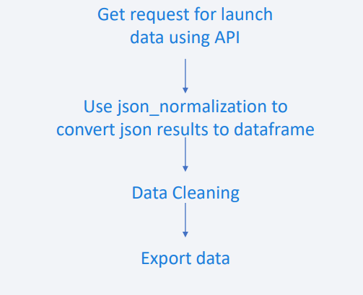
Data Collection – SpaceX API
Data collection-SpaceX API
Request url to collect and clean the data

Slide 9
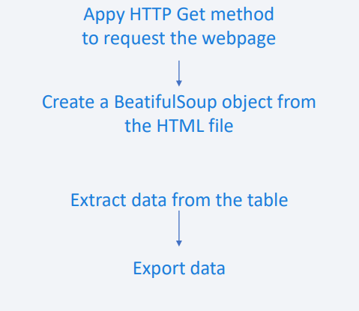
Data Collection - Scraping
Data collection-Web scraping
Web scrapping with beautifulsoup
Table into panda dataframe

Slide 10
Data Wrangling
Data analysis:
% of missing values
# of launches
# of used orbit

Slide 11
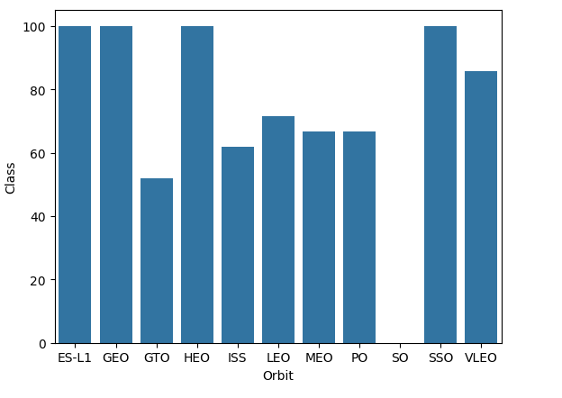
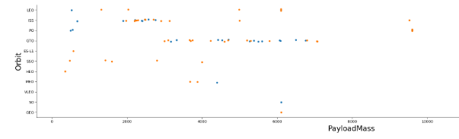
EDA with Data Visualization
Data visualization of the relationship of flight # vs. launch site; payload vs. launch site
https://github.com/silvia5/Coursera-Capstone/blob/main/jupyter-labs-eda-dataviz.ipynb.jupyterlite.ipynb

Slide 12
EDA with SQL
SQL:
Names of launch sites
Total mass by boosters from NASA
Average payload mass F9 v 1.1
Total # of mission out comes
https://github.com/silvia5/Coursera-Capstone/blob/main/Jupyter-Labs_EDA-SQL_Coursera_Sqllite.ipynb

Slide 13
Build an Interactive Map with Folium
Marked all launch sites and added map objects of launches for each site on the folium map.
Assigned the feature launch outcomes (failure or success) to class 0 and 1.i.e., 0 for failure, and 1 for success.
Used the color-labeled marker clusters, we identified which launch sites have relatively high success rate.
Calculated the distances between a launch site to its proximities.
https://github.com/silvia5/Coursera-Capstone/blob/main/Jupyter-Labs_EDA-SQL_Coursera_Sqllite.ipynb

Slide 14
Build a Dashboard with Plotly Dash
Interactive dashboard with Plotly Dash
Pie chart with total launches
Scatter graph with outcome and payload mass(kg) of different booster
https://github.com/silvia5/Coursera-Capstone/blob/main/spacex_dash_app.py

Slide 15
Predictive Analysis (Classification)
Used numpy and pd, split the data
ML models using GridSearchCV
Algo tunning to improve models
https://github.com/silvia5/Coursera-Capstone/blob/main/SpaceX_Machine_Learning_Prediction.ipynb

Slide 16
Results
Data analysis results
Interactive analysis demo
Predictive analysis

Slide 17

Section 2

Slide 18
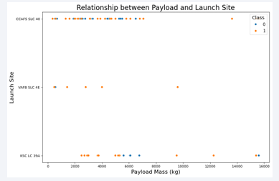
Flight Number vs. Launch Site
The larger flight amount at launch site, higher the success rate at launch site

Slide 19
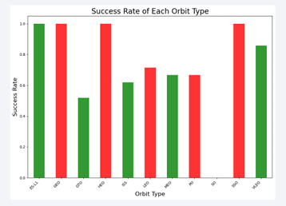
Payload vs. Launch Site
The larger payload mass for CCAFS SLC 40, higher the success rate for the rocket

Slide 20
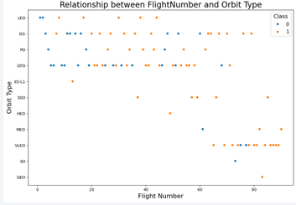
Success Rate vs. Orbit Type
Flight # vs. Orbit type
LEO – success relate to # of flights
GTO – no relation between flights and orbit

Slide 21
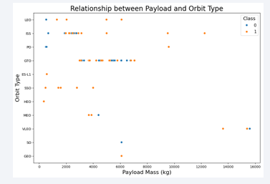
Payload vs. Orbit Type
Heavy payloads, more successful for PO, LEO, ISS orbits

Slide 22
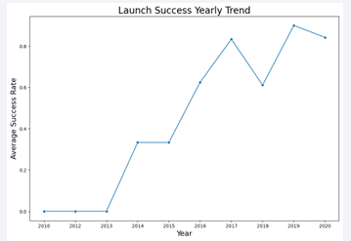
Launch Success Yearly Trend
Success rate start increase from 2013 until 2020

Slide 23
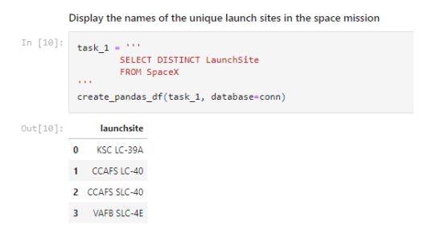
All Launch Site Names
Distinct for launch site names

Slide 24
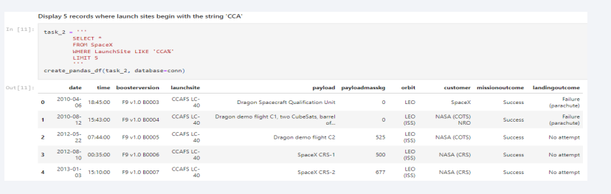
Launch Site Names Begin with 'CCA'
Use like to find the launch site that has CCA

Slide 25
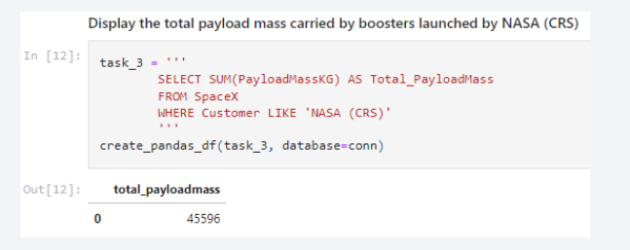
Total Payload Mass
sum() for the total of payloadmasskg

Slide 26
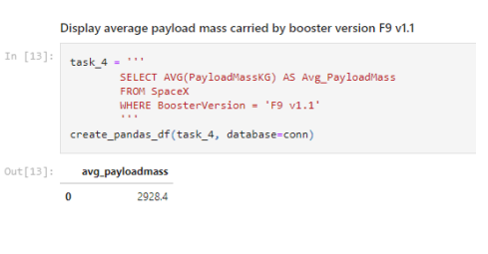
Average Payload Mass by F9 v1.1
ave() for the average of payloadmasskg

Slide 27
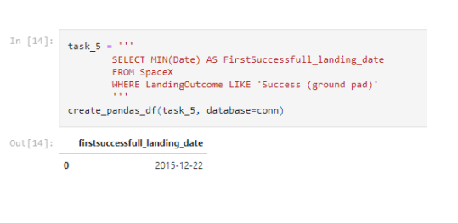
First Successful Ground Landing Date
Min() for the earliest data, which is the first

Slide 28
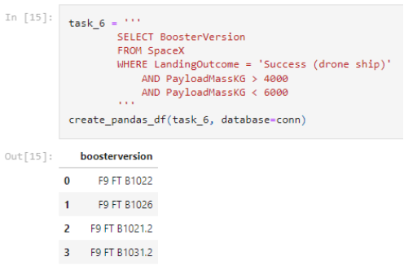
Successful Drone Ship Landing with Payload between 4000 and 6000
used the WHERE clause to filter for boosters which have successfully landed on drone ship and applied the AND condition to determine successful landing with payload mass greater than 4000 but less than 6000

Slide 29
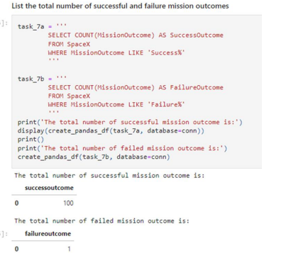
Total Number of Successful and Failure Mission Outcomes
used wildcard like ‘%’ to filter for WHERE Mission Outcome was a success or a failure.

Slide 30
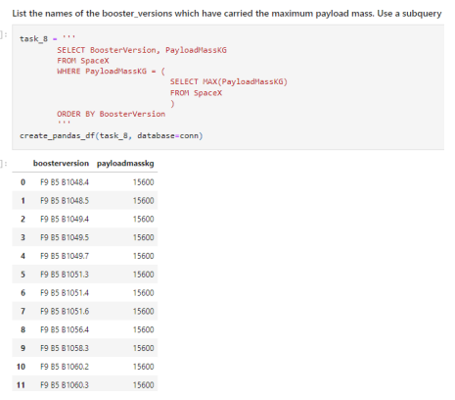
Boosters Carried Maximum Payload
booster that have carried the maximum payload using a subquery in the WHERE clause and the MAX() function.

Slide 31
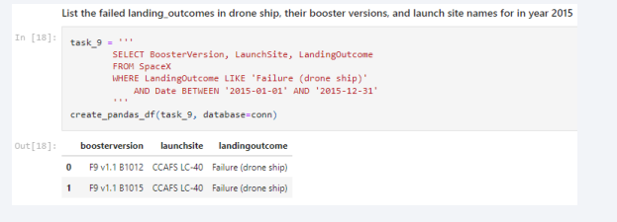
2015 Launch Records
combinations of the WHERE clause, LIKE, AND, and BETWEEN conditions to filter for failed landing outcomes in drone ship, their booster versions, and launch site names for year 2015

Slide 32
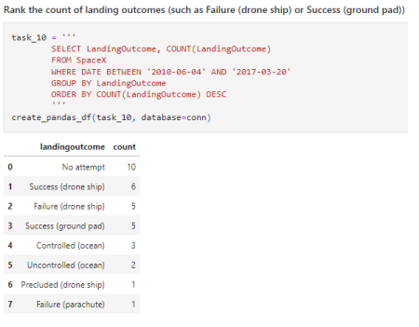
Rank Landing Outcomes Between 2010-06-04 and 2017-03-20
Selected Landing outcomes and the COUNT of landing outcomes from the data and used the WHERE clause to filter for landing outcomes BETWEEN 2010-06-04 to 2010-03-20.
Applied the GROUP BY clause to group the landing outcomes and the ORDER BY clause to order the grouped landing outcome in descending order.

Slide 33

Section 3

Slide 34
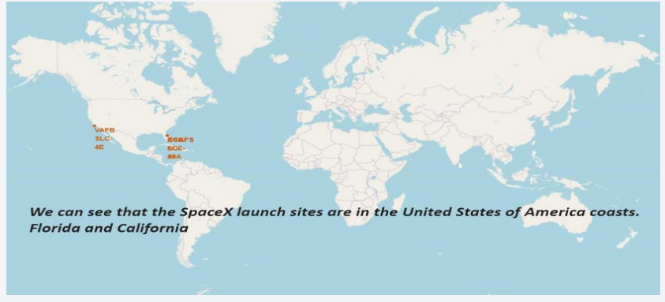
All launch sites

Slide 35
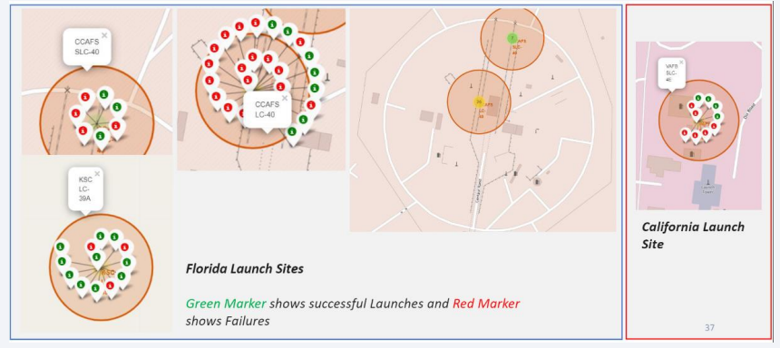
Markers with labels

Slide 36
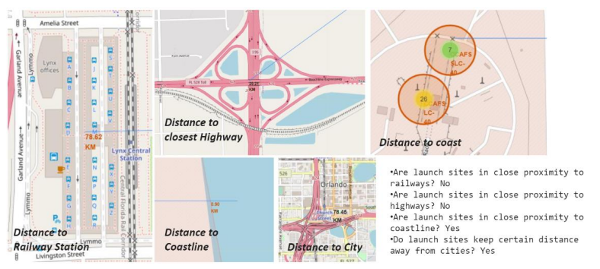
Launch site distance to landmarks

Slide 37

Section 4

Slide 38
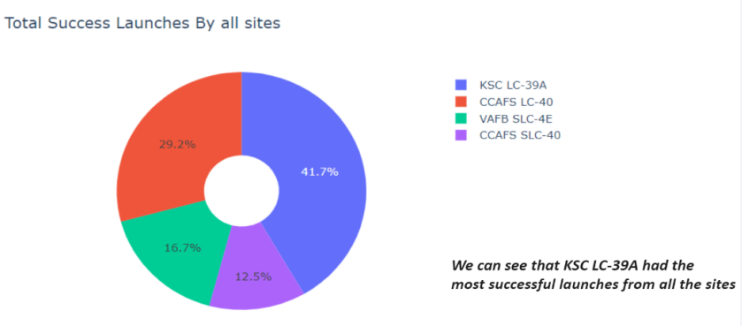
Success % by each launch site

Slide 39
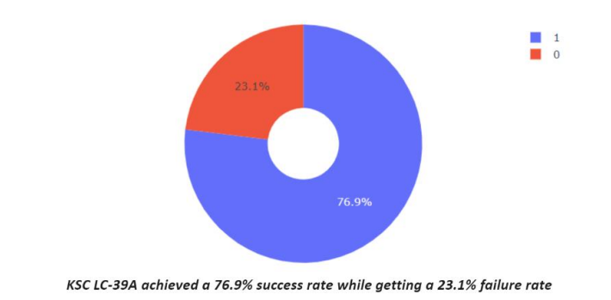
Launch site with highest launch ratio

Slide 40
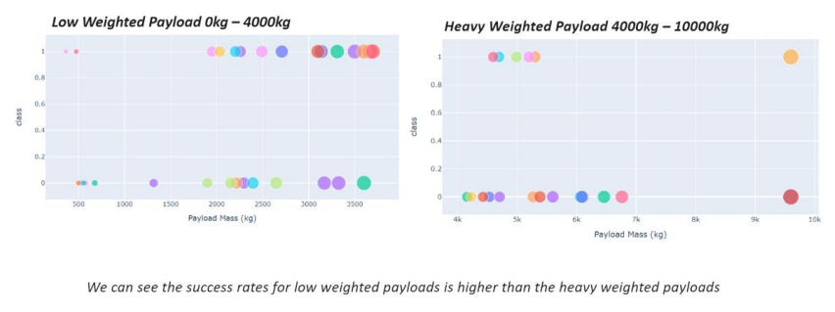
Payload vs. Launch outcomes

Slide 41

Section 5

Slide 42
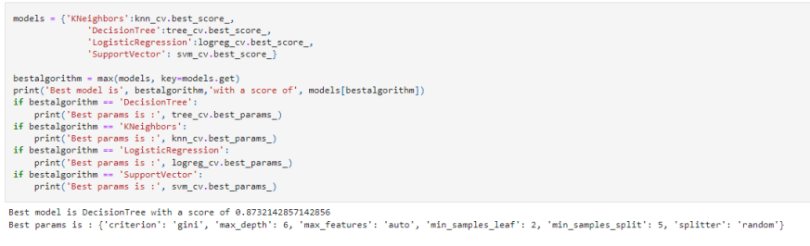
Classification Accuracy

Slide 43
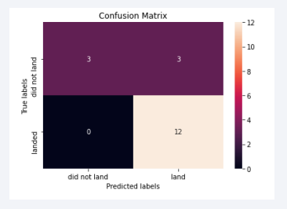
Confusion Matrix
Confusion matrix for the decision tree classifier shows that the classifier can distinguish between the different classes. The major problem is the false positives .i.e., unsuccessful landing marked as successful landing by the classifier.

Slide 44
Conclusions
The larger the flight amount at a launch site, the greater the success rate at a launch site.
Launch success rate started to increase in 2013 till 2020.
Orbits ES-L1, GEO, HEO, SSO, VLEO had the most success rate.
KSC LC-39A had the most successful launches of any sites.
The Decision tree classifier is the best machine learning algorithm for this task.

Slide 45


